Slide 1
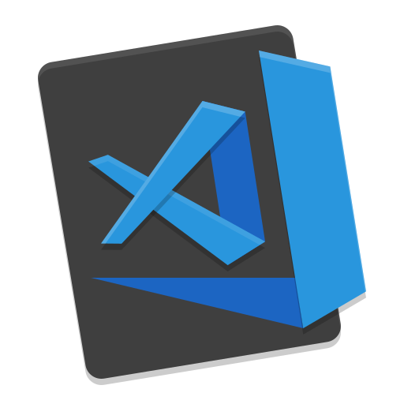

VS Code The last editor you will need
Wladymir Brborich

Slide 2


Why VS Code
Free !!
Extensions
Fast
Customizable
High community support
Embedded Terminal
Git Integration
Debugging support

Slide 3

I am not supposed to give my opinion… But…
Using VS Code is great, and it is even better when you learn how to customize it.
There are tons of features, so if you need something, probably VS Code can do it

Slide 4


Customizing it to your spec
Download Extensions
Icon Theme
Fonts and Font Ligatures
Editor Theme (Team Dark vs Team Light)
Choosing your terminal

Slide 5
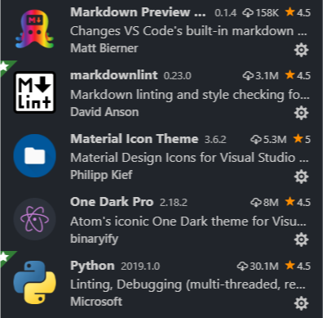
Extensions I use, and probably you will
Markdown Preview
Markdownlint
Material Icon Theme
One Dark Pro
Python
Python-autopep8
Beutify

Slide 6
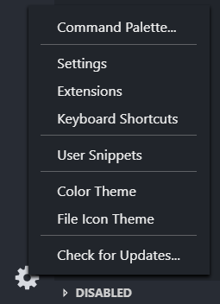
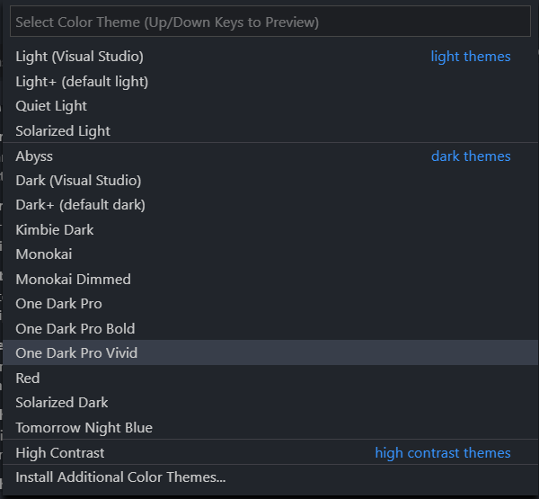
Changing the Editor theme
Go to settings
-> Color Theme
Scroll down until you like one, or install a new one

Slide 7
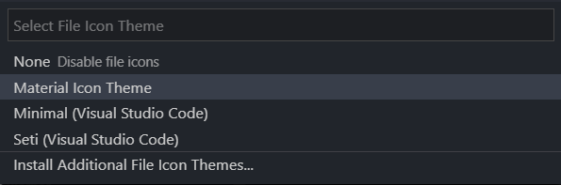
Changing the Icon theme
Go to settings
-> File Icon Theme
Scroll down until you like one, or install a new one

Slide 8
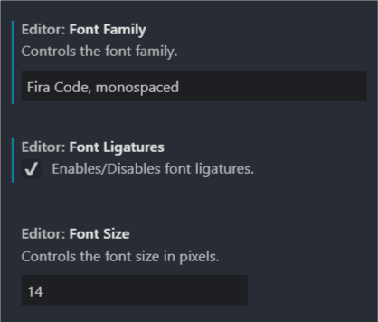
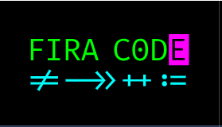
Font Ligatures
Great way to make your code cleaner and readable
Go to this repo: https://github.com/tonsky/FiraCode
Clone it or Download the whole repo
Install the fonts
In VS Code go to Settings -> Settings
Search for ‘font’
Change it to Fira Code

Slide 9
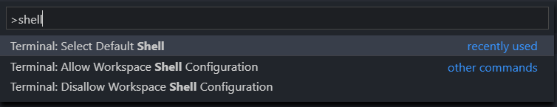
Choose your terminal
In windows you have either CMD or PowerShell but you can install a Linux subsystem terminal if you want
Open the ‘Command Pallet’ Ctrl + Shift +P
Search for shell
Pick your terminal

